Slide 1
MINI PROJECT ON “TEAM FORMATION TOOL ”

Slide 2

KISHKINDA UNIVERSITY
DEPARTMENT OF COMPUTER SCIENCE ENGINEERING
PROJECT MEMBERS
K AYESHA | KUB23CSE049
K IFFATH FATHIMA | KUB23CSE056
RIYAZUN NIKHAT | KUB23CSE116
UMMUL KHAIR | KUB23CSE151
RANJITHA | KUB23CSE153

Slide 3
INTRODUCTION
Our project automates the process of team formation for large groups of players, ensuring balanced and fair teams. This eliminates manual errors and biases by using an automated system to manage player profiles and track changes to team compositions.
The objective of our tool is to automate balanced team formation based on player skills and track any changes over time.

Slide 4
OVERVIEW OF THE PROJECT
Technology & Tools-
Programming Language:- Our project is developed using Python, a versatile and powerful programming language.
Object-Oriented Approach-
We adopted an object oriented approach by encapsulating the functionality into different classes and methods. This ensures the system remains modular and easy to extend.
Unit Testing-
Unit testing is implemented using Python’s unit test framework, ensuring reliability in each project component.

Slide 5
CORE COMPONENTS
Core Components –
PLAYER CLASS:-The Player class handles CRUD operations (Create, Read, Update, Delete) for player profiles, providing flexible management of player data.
TEAM CLASS:-The Team class is responsible for managing rosters, adding/removing players, and calculating the average skill level of a team.
ROASTER BALANCE CLASS :-The Roster Balancer class implements a round-robin algorithm to balance teams based on player skills, ensuring fairness
FORMATION TRACKER CLASS:-The Formation Tracker class logs changes made to teams, allowing administrators to track roster modifications.

Slide 6
VISION OF THE PROJECT
1. Automate Team Formation: Create a tool that automates balanced team creation based on player skills, eliminating manual errors and bias.
2. Ensure Fairness: Provide an unbiased, transparent system for team selection, ensuring fair distribution of players.
3. Scalable Solution: Design a modular and scalable system that can be adapted for different industries like sports, gaming, and corporate environments.
4. Future-Ready: Build a flexible platform capable of incorporating future enhancements such as more complex team dynamics and performance tracking.

Slide 7
REQUIREMENTS SPECIFICATIONS
Software Requirements:
Programming Language: Python 3.x
Development Environment: VS Code, PyCharm, or any Python IDE.
Unit Testing Framework: Python's unit test library.
Version Control: Git for source code management.
Hardware Requirements : -
Processor: Intel Core i5 or above.
RAM: Minimum 8GB for efficient processing.
Storage: Minimum 500GB HDD or SSD.

Slide 8
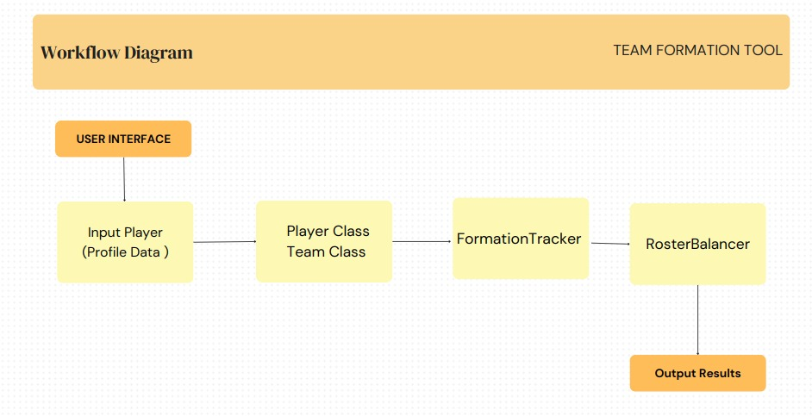
PROJECT ARCHITECTURE DIAGRAM

Slide 9
MODULES
MODULE 1 :Player Management Module
Functionality for CRUD operations (Create, Read, Update, Delete) on player profiles.
Manages player data like player ID, name, skill level, etc.
MODULE 2 :Team Management Module
Handles team creation and deletion.
Allows adding and removing players from specific teams.
Calculates and manages team metrics, such as average skill level.
MODULE 3 : Formation Tracking Module
Tracks and logs changes made to team formations (like adding or removing players).
Keeps a history of team changes for future reference and analysis.
MODULE 4:Roster Balancer Module
Balances teams based on player skill levels using a custom algorithm.
Ensures fair distribution of skills across all teams.
MODULE 5:User Interface Module
Provides a menu-based system for user interaction.Facilitates input for creating players, managing teams, and viewing team matrices
Displays results and tracked changes in an organized manner.

Slide 10
FUTURE ENHANCEMENT
User Interface (UI) Development:-
Provides an intuitive and accessible way for users to interact with the tool without relying solely and command-line operations.
Advanced Balancing Algorithms:-
Enhance the Roster Balancer with more sophisticated algorithms that consider multiple criteria such as positional balance, player synergy, and real-time performance data.
API Development:-
Create RESTful or GraphQL APIs using FastAPI or Flask-RESTful to allow external applications and services to interact with the Team Formation Tool

Slide 11
CONCLUSION
The Team Formation Tool POC successfully automates and manages balanced team formation. Its scalability and modularity make it a versatile solution for various applications.

Slide 12
REFERENCES
Books:
"Python Crash Course" by Eric Matthes
A popular beginner-to-intermediate guide to Python, covering object-oriented programming and building practical projects.
"Fluent Python" by Luciano Ramalho
Advanced resource on Python programming, covering more sophisticated topics, including class design and object-oriented programming.
Websites:
Python Official Documentation (https://docs.python.org/)
GeeksforGeeks (https://www.geeksforgeeks.org/)

Slide 13


